Slide 1
The problem of overfitting

Slide 2
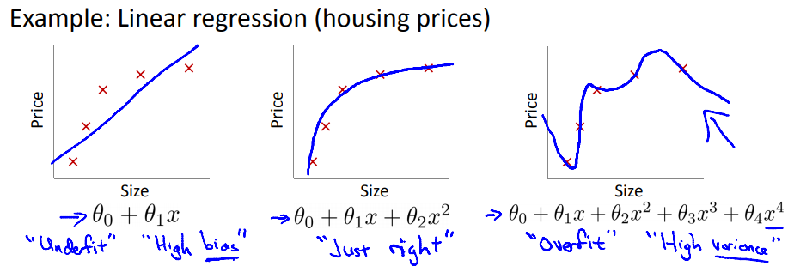
Overfitting

Slide 3
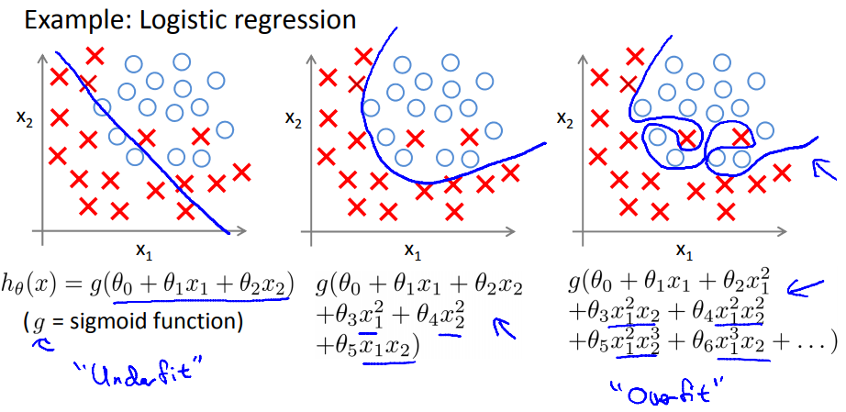
Overfitting

Slide 4
Addressing overfitting:
Options:
Reduce number of features
Manually select which features to keep.
Model selection algorithm
Regularization.
Keep all the features, but reduce magnitude/values of parameters .
Works well when we have a lot of features, each of which contributes a bit to predicting y

Slide 5
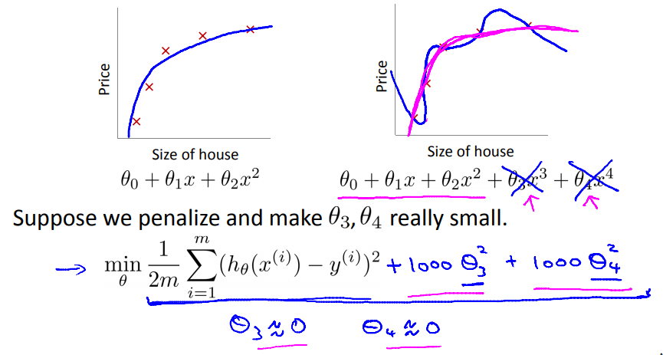
Cost function
If we have overfitting from our hypothesis function, we can reduce the weight that some of the terms in our function carry by increasing their cost.

Slide 6
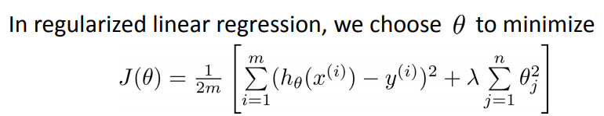
Regularization
if λ is set to an extremely large value, algorithm results in underfitting

Slide 7
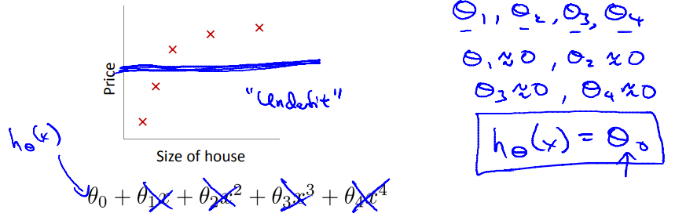
Regularization

Slide 8
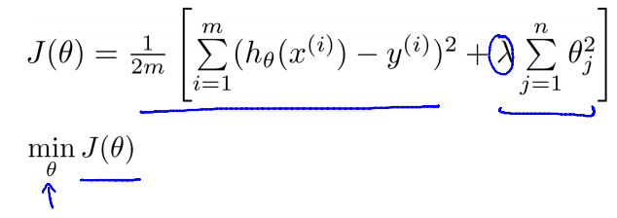
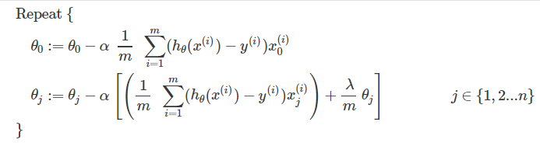
Regularized linear regression
Gradient descent algorithm:

Slide 9
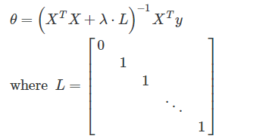
Normal equation

Slide 10
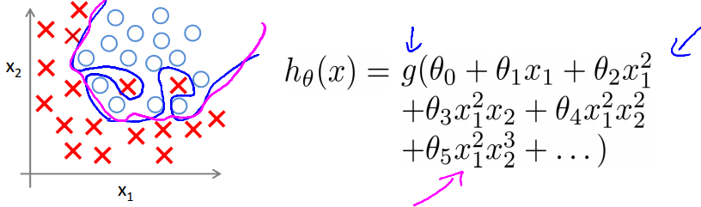
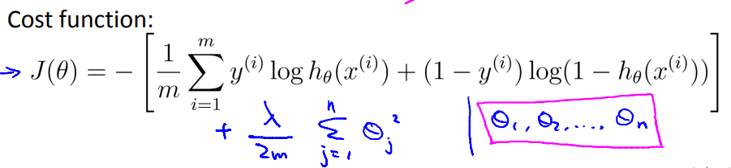
Regularized logistic regression.

Slide 11
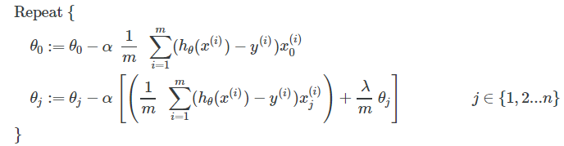
Gradient descent algorithm

